Slide 1
A New Era in Mobile Clinical Care
MobileCARE
Carl Schulman MD, PhD MSPH

Slide 2
The Problem
The process of clinical care, including:
- documentation (and billing)
- real-time performance support
- telemedicine/communication
Lacks a technologically personalized, mobile and integrated approach.

Slide 3
The Solution
Bring true point-of-care to clinicians
Employ the latest hand-held technologies
Access and input patient data quickly and effectively at the bedside.
The device serves as the next important step in allowing clinicians to integrate mobile patient care and the Electronic Medical Records (EMR).

Slide 4
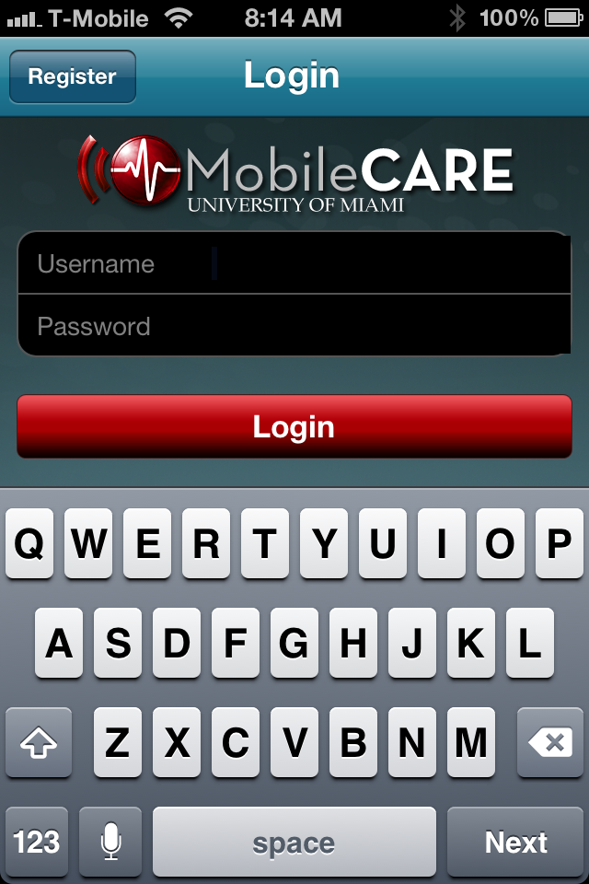
MobileCare
An effective solution for accessing and documenting patient information anytime, anywhere using your handheld device
Always with clinician
Smartphone
Tablet
Provides consistent informatics interface during training and the provision of care
Bidirectional data interfaces to EMRs
Integrated application suite
Documentation
Performance Support
Telemedicine

Slide 5
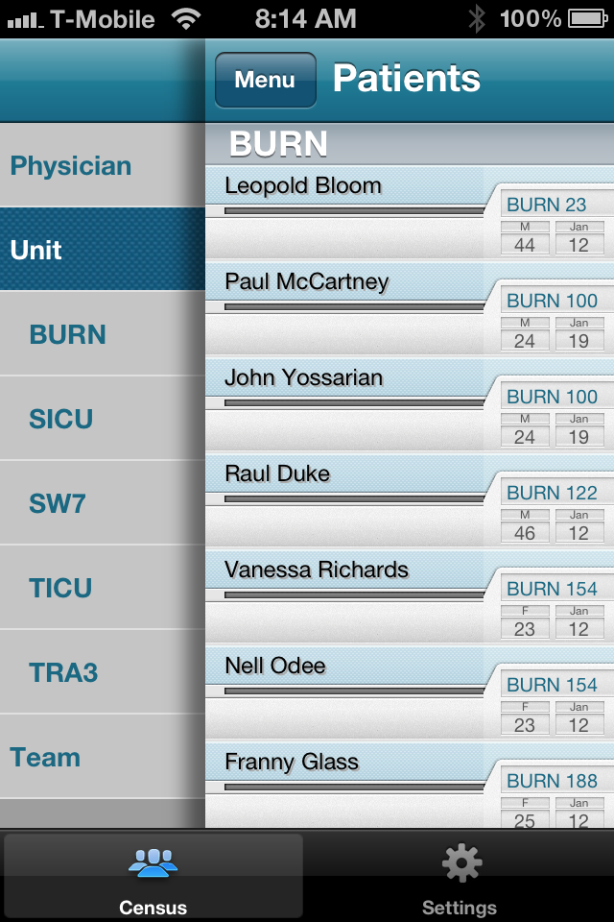
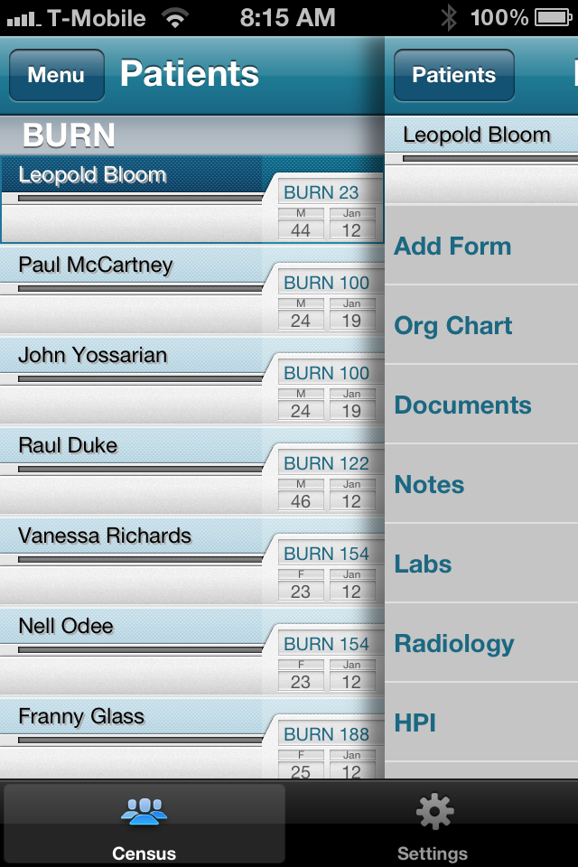
Census and Navigation
Real-time Census
Easy Navigation
Notifications

Slide 6
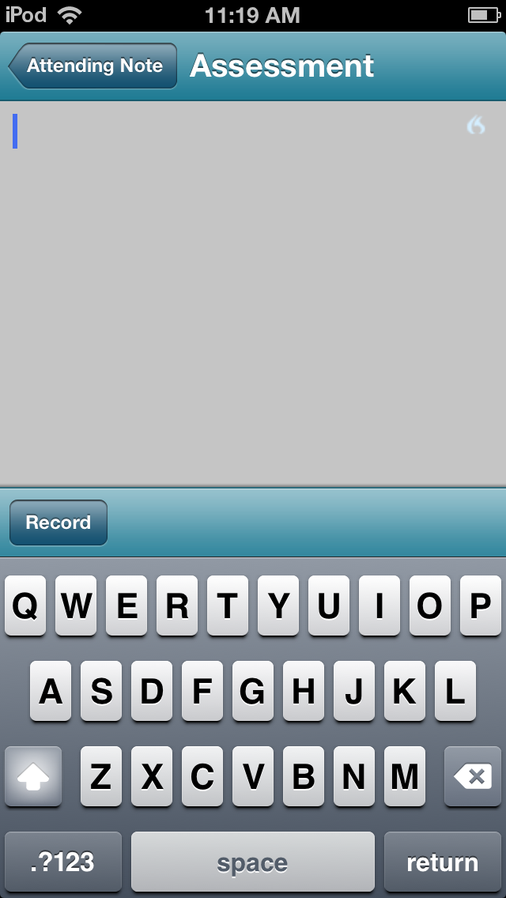
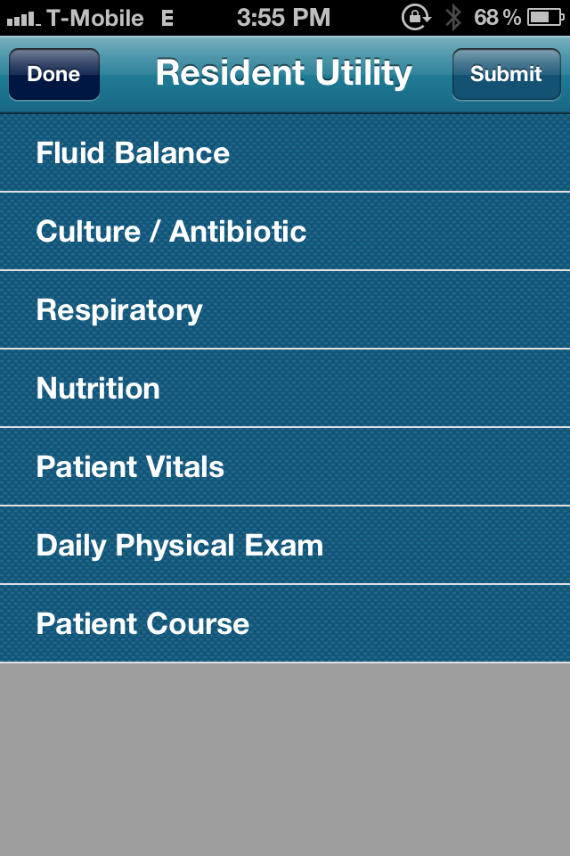
Simple Data Entry/Interface
Daily Data
Automate Data Gathering
Real-time Transcription

Slide 7
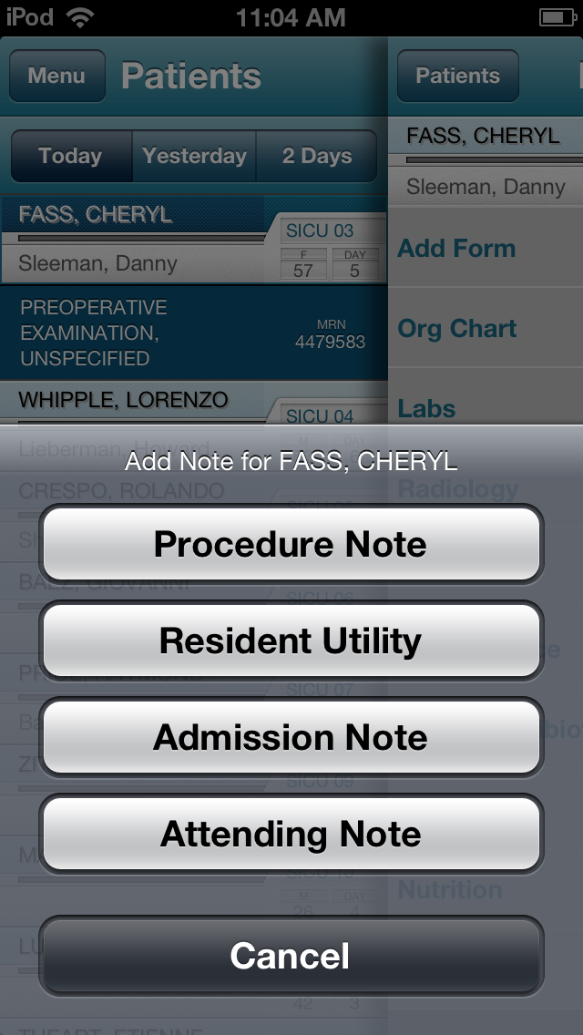
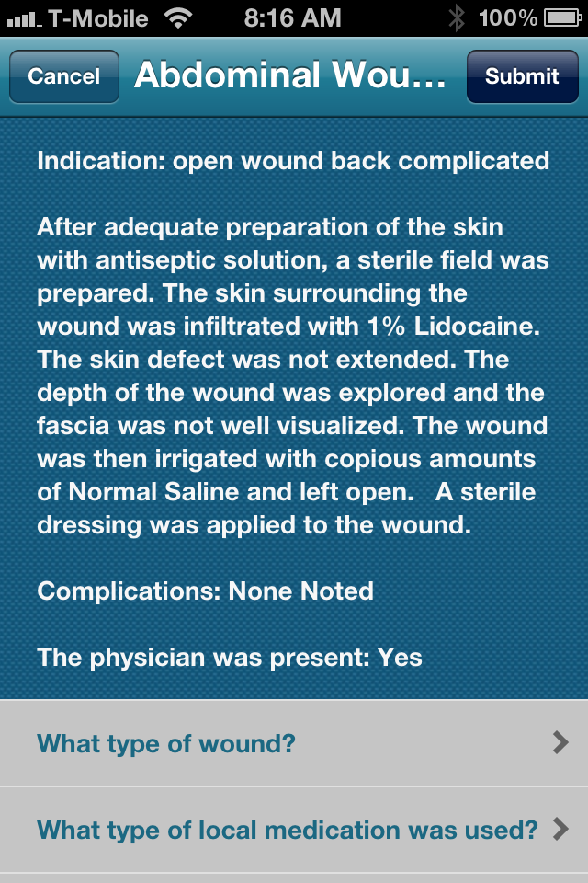
Quicker/Improved Documentation
Drop Down Menus
Templated Notes
Real-time Transcription

Slide 8
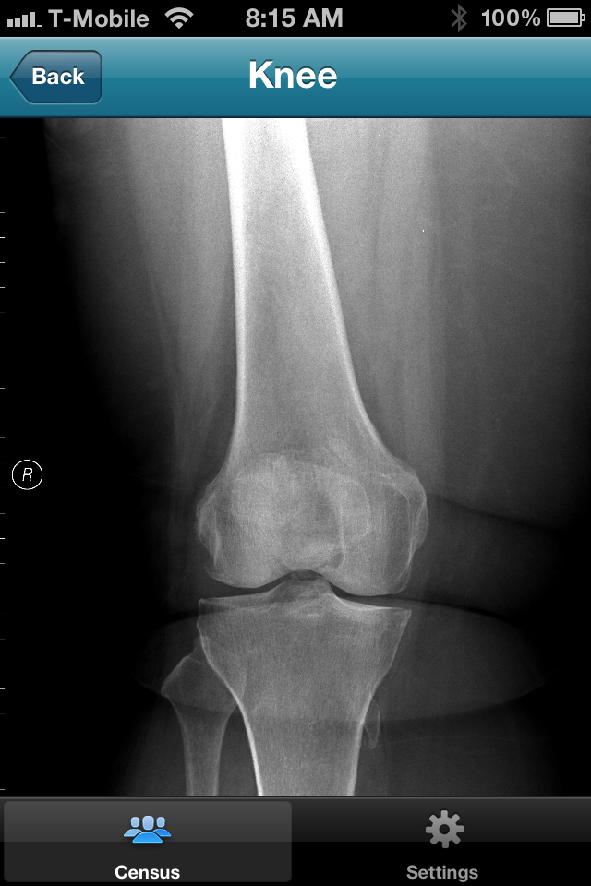
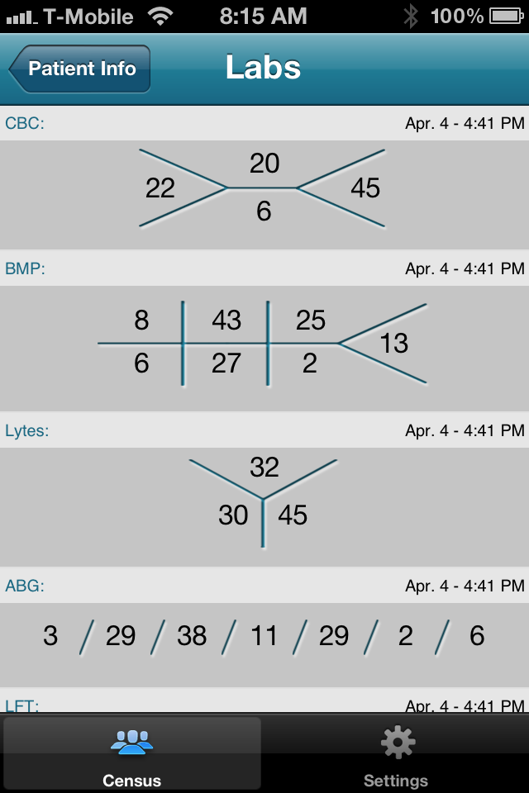
Intuitive Data Display
PACS Integration
Iconographic Displays

Slide 9
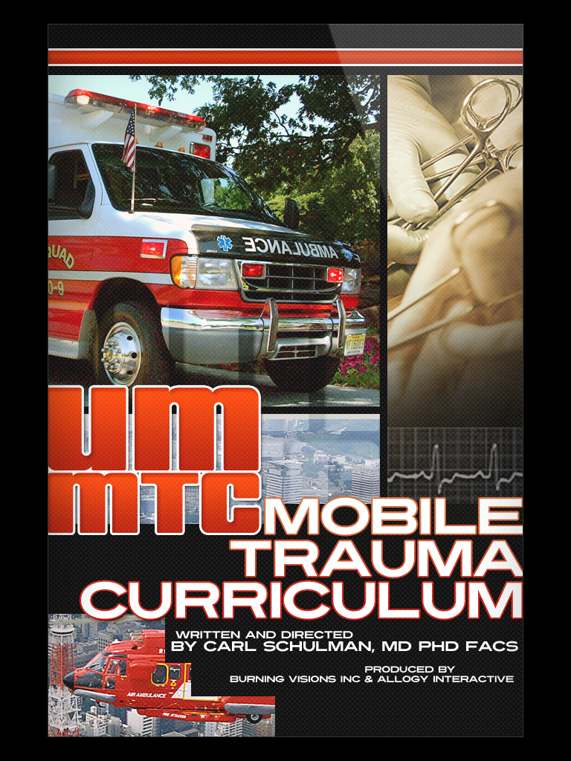
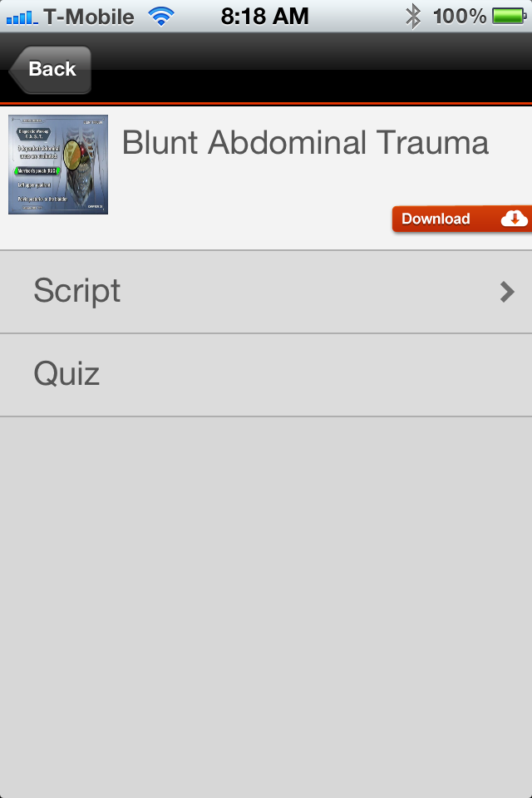
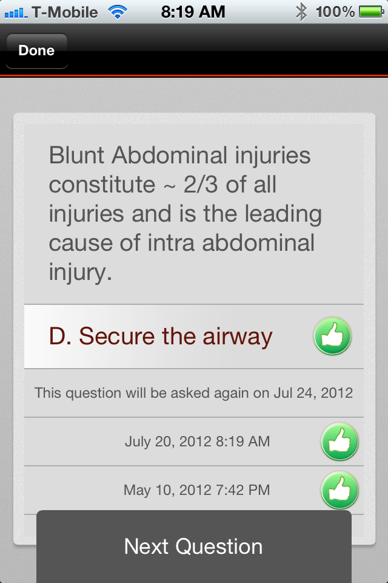
Real-Time Performance Support

Slide 10
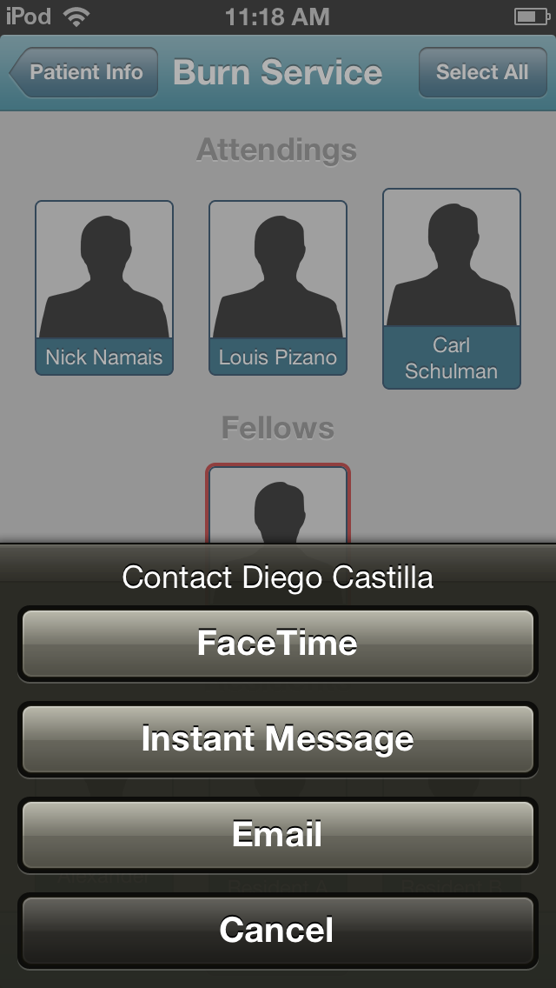
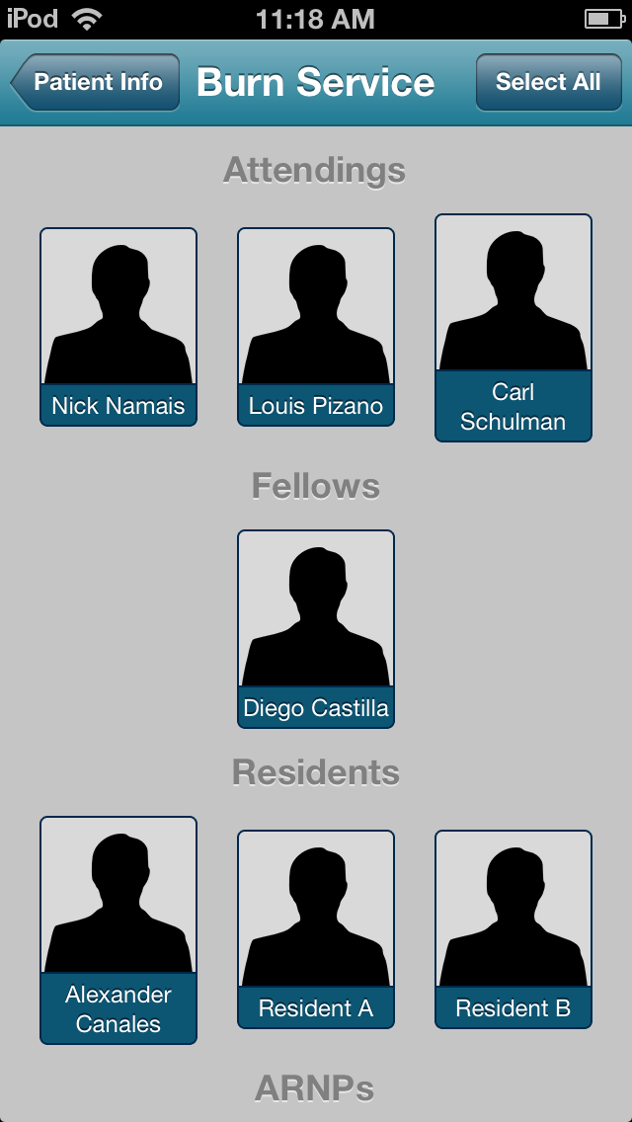
Telemedicine

Slide 11
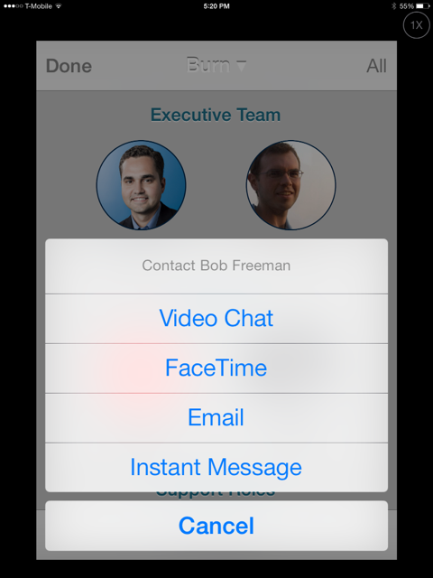
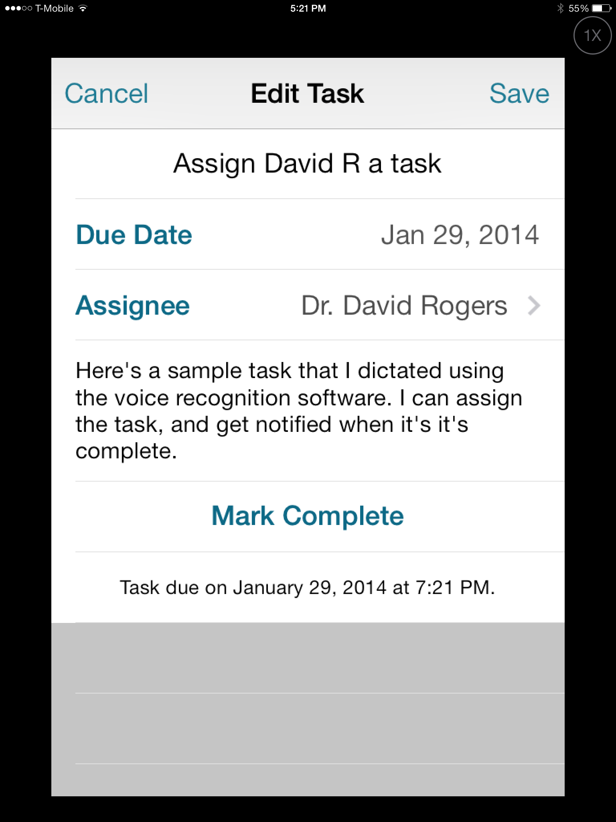
Task Tracking – Handoffs - Surveillance
Build Dynamic Teams
Communicate
Task Assignment
and Tracking

Slide 12
Performance Support
and Continuing Education

Slide 13
Curriculum
Trauma Bundle 1
Intubation
Central Line Placement
Surgical Cricothyroidotomy
DPL
Chest Tube
Trauma Bundle 2
Emergency Thoracotomy
Pulmonary Artery Catheter Placement
Pericardiocentesis
Lower Extremity Fasciotomy
Emergency Burr Hole
Trauma Bundle 3
Abdominal Wound Exploration
Percutaneous Tracheostomy
FAST Exam

Slide 14
Trauma Curriculum
Epidemiology & Injury Prevention
Initial Assessment – ABC’s
Management of Shock
Penetrating Neck and Chest Injuries
Penetrating Abdominal Trauma
Blunt Abdominal Trauma
Liver, Kidney and Splenic Trauma
Stomach, Pancreas, and Intestinal Trauma
Abdominal Vascular Injury
Pelvic Fractures
Trauma Laparotomy / Damage Control Techniques
Peripheral Vascular Injuries
Upper & Lower Extremity Fractures
Burns
Principles of Critical Care
*ATTC Team Training*
TeamSTEPPS

Slide 15
Knowledge Assessment
Video on Management of Shock
Methods: Pre-Test, Video OR PowerPoint Lecture (Control), Post-Test, Scenario Test
Suggests Learning Modalities equal, no significant differences
 | Video | Control | Total
FST Members | 53 | 60 | 113
Medical Students | 51 | 45 | 96
Residents | 52 | 49 | 101
TOTAL | 165 | 157 | 322

Slide 16
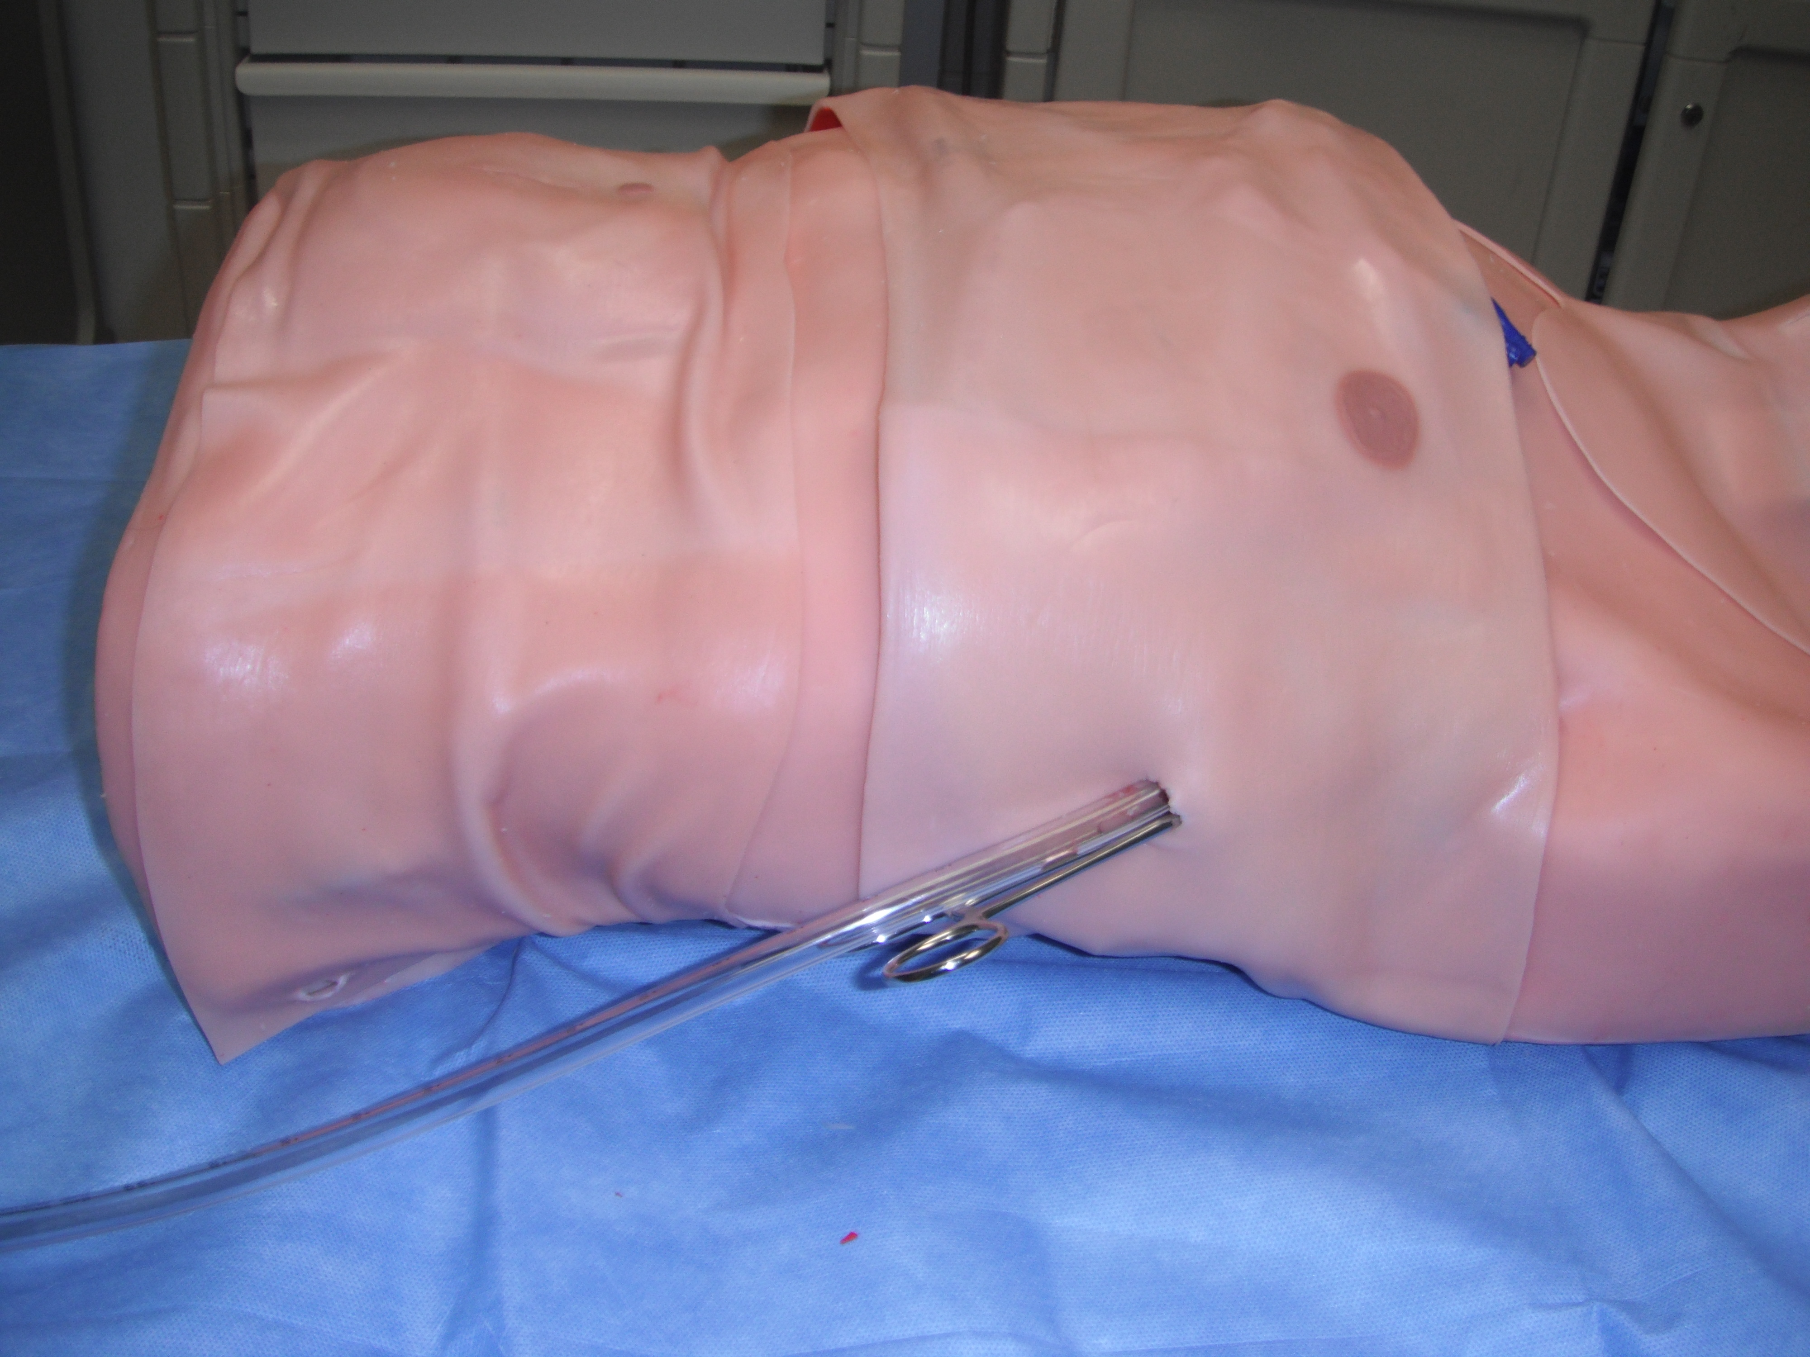
Simulation Assessment
Video on Tube Thoracostomy
Methods: Questionnaire, Video OR Control, Simulation on TraumaMan, Evaluated by 16 item Skills Checklist
Results: Video group correctly identified insertion site 27.5% more, correctly prepped site 13% more, & avoided neurovascular injury 22% more, versus the control group.
70% never inserted a chest tube before
Overall t-test: p <0.01
 | Video | Control | Total
Medical Students | 17 | 16 | 33
FST Members | 11 | 10 | 21
Residents | 22 | 22 | 44
TOTAL | 50 | 48 | 98

Slide 17
Validation & Successes
Used by the ATTC
Modules incorporated into ATLS
Intubation, Chest Tube, Surgical Cric, DPL, CVL
30,000 Physicians trained annually
Didactic and mobile application
Curriculum accepted by Surgical Council on Resident Education (SCORE)
WebPortal for training all General Surgery residents

Slide 18
New Advancements
Clinical Decision Support
Hands-free operation
Device Integration
Direct Sensor Input

Slide 19
4 Main Points
Based on physician workflow
Integrates real-time performance support
Collaboration
Patient safety
Efficiency
Tied to billing and coding

Slide 20
Thank You
Questions?
Contact Information
Carl Schulman (305) 585-1076
cschulman@med.miami.edu

