Slide 1
Medical Device and HIT System Integration Implications for healthcare quality, safety, and innovation
Federal HIT Summit
Nov 20, 2014
Washington, DC
Julian M. Goldman, MD
Director, Program on Interoperability, Mass General Hospital
Medical Director, Partners HealthCare Biomedical Engineering
Anesthesiologist, MGH/Harvard Medical School
Contact information: www.jgoldman.info

Slide 2
1999
2013
1999 IOM published “To Err Is Human” up to 98,000 people a year die because of mistakes in hospitals.
2010 the Office of Inspector General for Health and Human Services said that bad hospital care contributed to the deaths of 180,000 patients in Medicare alone in a given year.
2013 Journal of Patient Safety: between 210,000 and 440,000 patients each year who go to the hospital for care suffer some type of preventable harm that contributes to their death.
“That would make medical errors the third-leading cause of death in America, behind heart disease, which is the first, and cancer, which is second. “
Notes:
http://journals.lww.com/journalpatientsafety/Fulltext/2013/09000/A_New,_Evidence_based_Estimate_of_Patient_Harms.2.aspx
http://www.propublica.org/article/how-many-die-from-medical-mistakes-in-us-hospitals

Slide 3
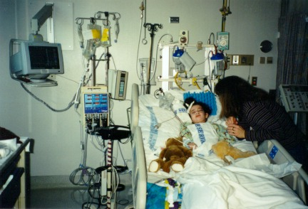
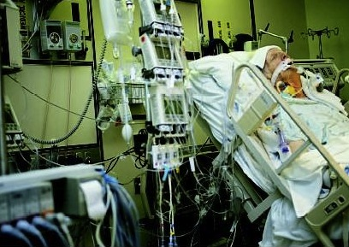
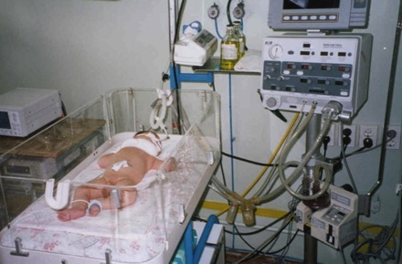
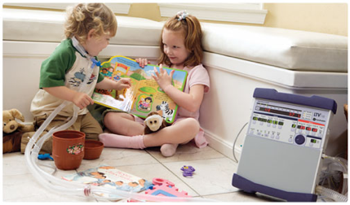
Devices, processes, non-integrated system → errors
Home ventilator
Notes:
http://www.nwscape.com/brooke/images-new/icu-l.jpg
http://employees.csbsju.edu/lrodgers/images/baby%20icu.jpg
http://www.perfusion.arizona.edu/images/OR%20perfusion.jpg
http://www.fitsense.com/b/images/cardiac%20surgery%20cw.jpg

Slide 4
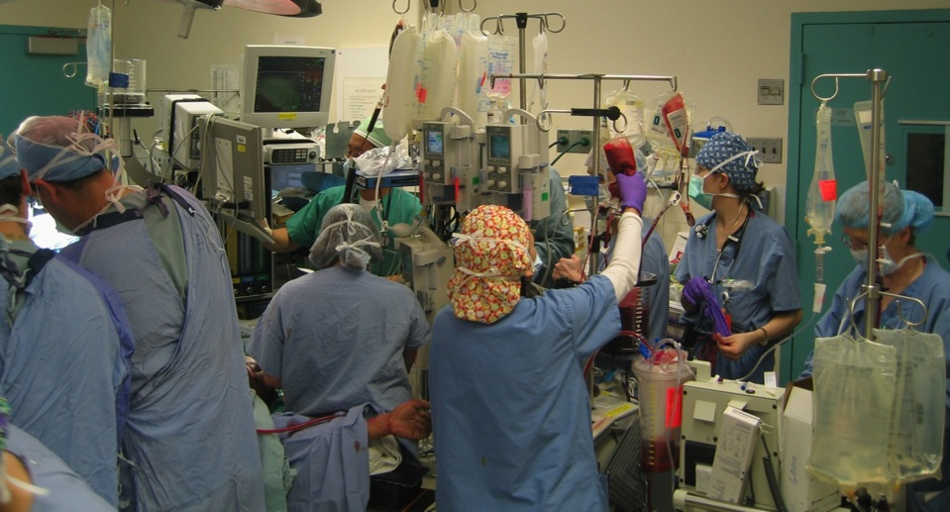
OR scene – patient’s life saved: Clinicians need timely, accurate data to reduce error, treatment delays, injuries and deaths. Is that how we practice today? Where are innovative solutions?

Slide 5
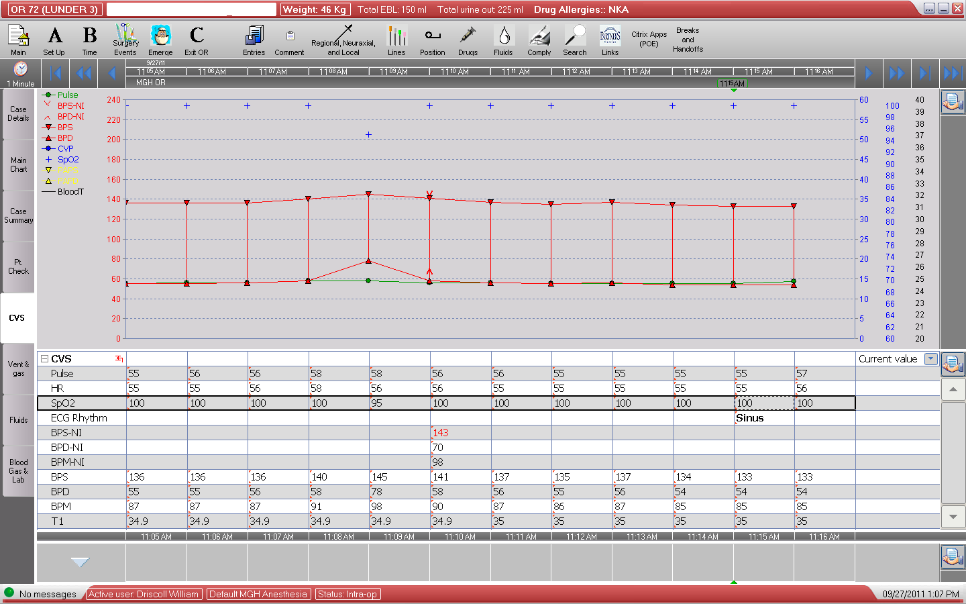
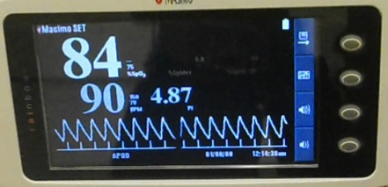
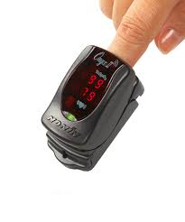
Medical Devices generate “First Mile” of data (from patient)
Pulse Oximeters measure oxygen saturation – displayed as SpO₂ %
Pulse Oximeter oxygen saturation is 84% on instrument display and in EHR
EMR
Blood Pressure
Bluetooth pulse oximeter
Julian M. Goldman, MD / MGH
Notes:
IoT – insert Nonin photo

Slide 6
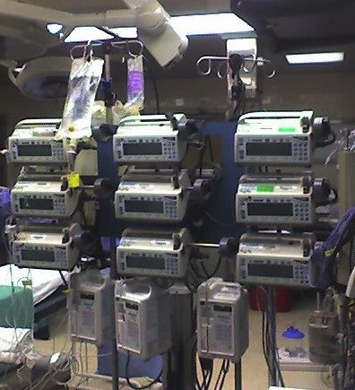
These infusion pumps are for use on ONE patient
Medical Devices are also the “Last Mile”
(data back to devices)
Example - Infusion technology:
Decision support?
Prevent contra-indicated infusion?
“Artificial pancreas” Capabilities? (closed loop)
Consolidate all data for adverse event analysis?
Check device status, software version? Recall?
Adjust settings remotely?

Slide 7
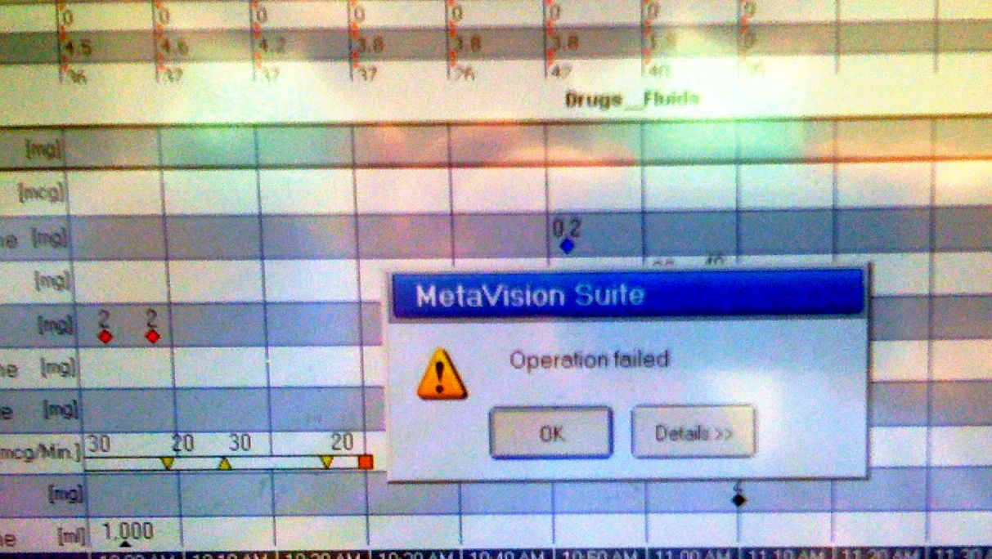
In interdisciplinary settings, language matters …
Actual screen capture from intra-operative EMR during surgery
Julian M. Goldman, MD / MGH
Notes:
Source – Metvision / MGH / Goldman

Slide 8
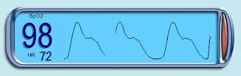
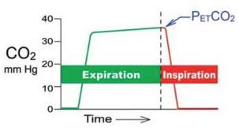
Discrete, device-based alarms
Low SpO2 Alarm = 90%
Resp rate Alarm
< 8 or > 20
ETCO2 >x or <x?
Must function without context
Notes:
Pulse ox simulator
http://vam.anest.ufl.edu/simulations/pulseoximeter.php
Capnogram
https://encrypted-tbn0.gstatic.com/images?q=tbn:ANd9GcSo2H8dY0xXmxgxs5B3AdzI9kmrYLFNywWcrcx1tTsR0eRa48ns2w

Slide 9
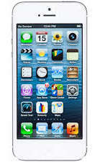
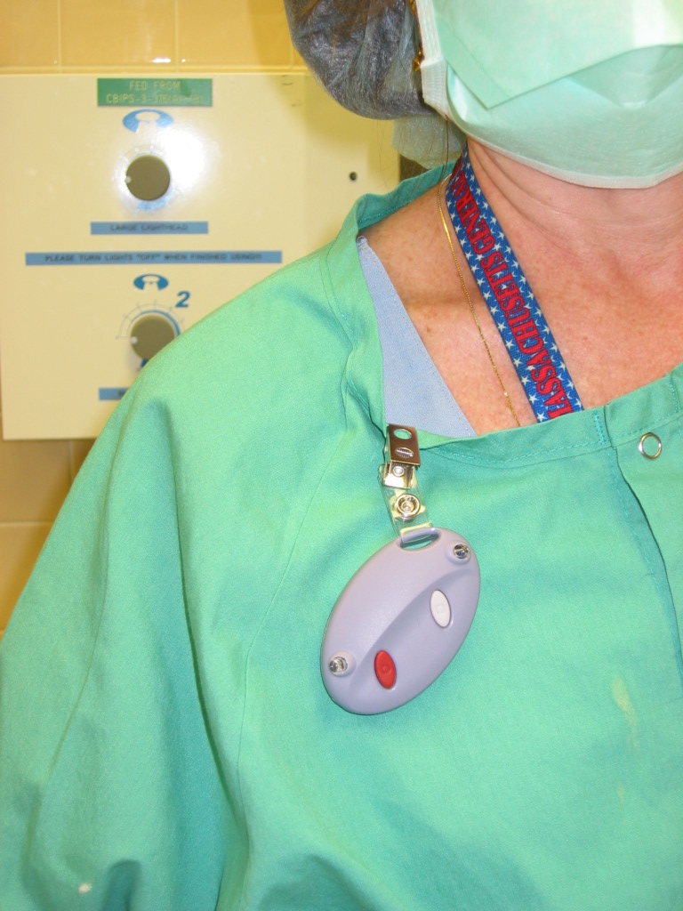
Context-based “smart” alarms
Is this an IOT approach? Maybe …
EMR
Smart Alarm
Use trends
Data fusion
context
Low SpO2 Alarm = 80%
Resp rate Alarm
< 8; CO₂ > 60
Correct Time
Notes:
Pulse ox simulator
http://vam.anest.ufl.edu/simulations/pulseoximeter.php
Capnogram
https://encrypted-tbn0.gstatic.com/images?q=tbn:ANd9GcSo2H8dY0xXmxgxs5B3AdzI9kmrYLFNywWcrcx1tTsR0eRa48ns2w

Slide 10
Pulse Oximeter Data example
Oxygen Level Low
WHY????
JM Goldman MD / MGH

Slide 11
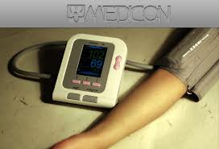
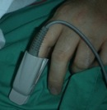
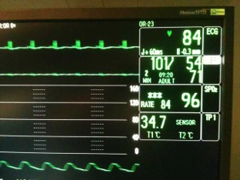
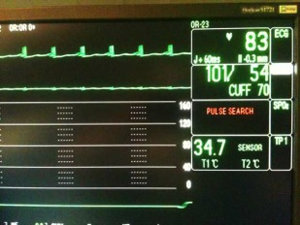
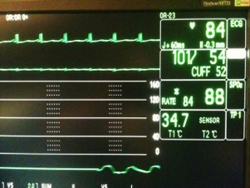
BP cuff - Pulse Oximeter Interaction
Not reall low oxygen
“Bad” data
JM Goldman MD / MGH
Baseline
Cuff inflates – loss of finger signal
Blood returns to finger

Slide 12
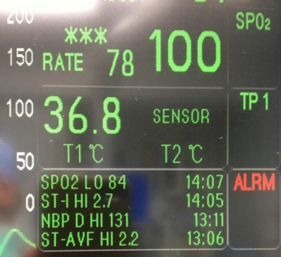
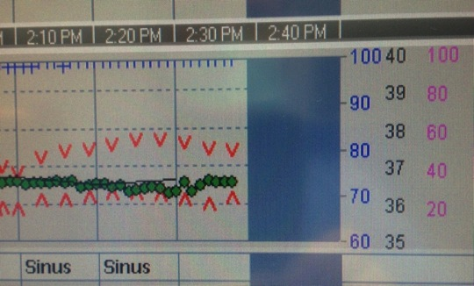
We must not discard data!!
No evidence of 84% SpO₂ in EHR
(Blue ticks representing SpO₂ values
Don’t change)
Monitor Displays Low Oxygen Level (SpO₂₎ Alarm Event “84%” at 2:07
Julian M. Goldman, MD / MGH
Notes:
Data from Lunder OR 54 May 28 2013
JM Goldman MD

Slide 13
Sources of variation in EHR documentation due to Data Sampling
60 Seconds
Example of possible EHR sample points for 1-minute recording
Based on this example,
EHR May record SpO2 as:
98%
92%
80%
75%
Etc.
Patient’s “actual” SpO2
minimum = 70%
Notes:
Closest approximation of “actual” is pulse oximeter set to “beat-to-beat” mode, or 2-second averaging time.
Better data could be obtained from manufacturers proprietary data stream, but is not necessary for this study.

Slide 14
Proposal: Can an Integrated Clinical Environment (ICE) add “error resistance” to healthcare delivery?
Notes:
http://www.economist.com/news/special-report/21593583-proliferating-digital-platforms-will-be-heart-tomorrows-economy-and-even

Slide 15
Standard for the “Integrated Clinical Environment” ASTM F2761-09
“Essential safety requirements for equipment comprising the patient-centric integrated clinical environment (ICE) — Part 1: General requirements and conceptual model”
Provides a standards-based system architecture intended to support safe interoperable medical systems
Recognized by FDA 8/2013: http://www.gpo.gov/fdsys/pkg/FR-2013-08-06/pdf/2013-19020.pdf
Notes:
Developed by experts convened through MD PnP, TATRC BAA

Slide 16
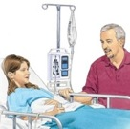
Integrated Clinical Environment - Architecture
From ASTM F2761-09
Clinicians
ICE System
Apps for PCA Safety, Smart Alarms, Remote Notification, Team coordination
EMR
ICE External
Interface
ICE Supervisor (runs apps)
ICE Network Controller
ICE Data Logger
Medical Device or other equipment
Medical Device or other equipment
Medical Device or
other equipment
Patient and Family
Standard recognized by FDA in August 2013
Notes:
Patient Image: http://www.uofmmedicalcenter.org/healthlibrary/Article/88979
Clinician image: Icon from medicalappjournal.com

Slide 17
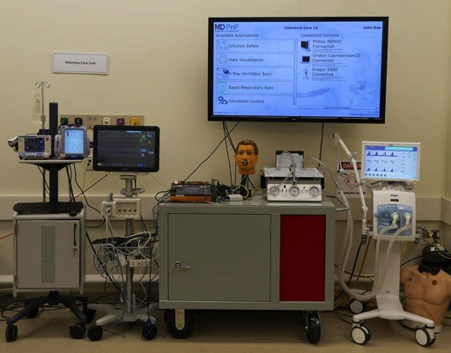
OpenICE Open-Source Platform
Based on ASTM F2761 “Essential safety requirements for equipment comprising the patient-centric integrated clinical environment (ICE), IEEE 11073 nomenclature; OMG DDS pub/sub messaging middleware
Apps
Caregiver
ICE Supervisor
Black Box
Recorder
External
Network
Network Controller
Data
Logger
Adapter
Adapter
Adapter
PulseOx
Pump
Patient Mon.
Patient
www.openice.info
Notes:
New version is built on open source implementation of open standards.
Open ICE equipment interfaces translate proprietary manufacturer-specific interfaces to common data representation and communication protocol
Better patient simulator allows patient algorithms to plug in
Devices are plug-and-play: any device that provides necessary interface can be used

Slide 18
“Medical IoT”
(Internet of Things)
Apps for smart alarms; med safety; equipment management
Asking a lot of the platform
What if…
Notes:
http://www.nwscape.com/brooke/images-new/icu-l.jpg
http://employees.csbsju.edu/lrodgers/images/baby%20icu.jpg
http://www.perfusion.arizona.edu/images/OR%20perfusion.jpg
http://www.fitsense.com/b/images/cardiac%20surgery%20cw.jpg

Slide 19
Medical Device “Plug-and-Play” Interoperability Program (MD PnP)
Founded in 2004, the MD PnP research program is a multi-institutional community with Lab based at Massachusetts General Hospital (MGH), with grant support from NIH/NIBIB, NSF, DoD/TATRC, and NIST
Mission: lead the adoption of open standards and technologies for medical device interoperability to improve patient safety

Slide 20
MD PnP Lab at MGH/PHS
Vender-neutral sandbox for experimenting with device interoperability solutions (standards technologies, products)
Contains devices – production and research
Supports diverse collaborators
Notes:
Add lab funding
Better pictures

Slide 21
www.openice.info
www.mdpnp.org

