Slide 1
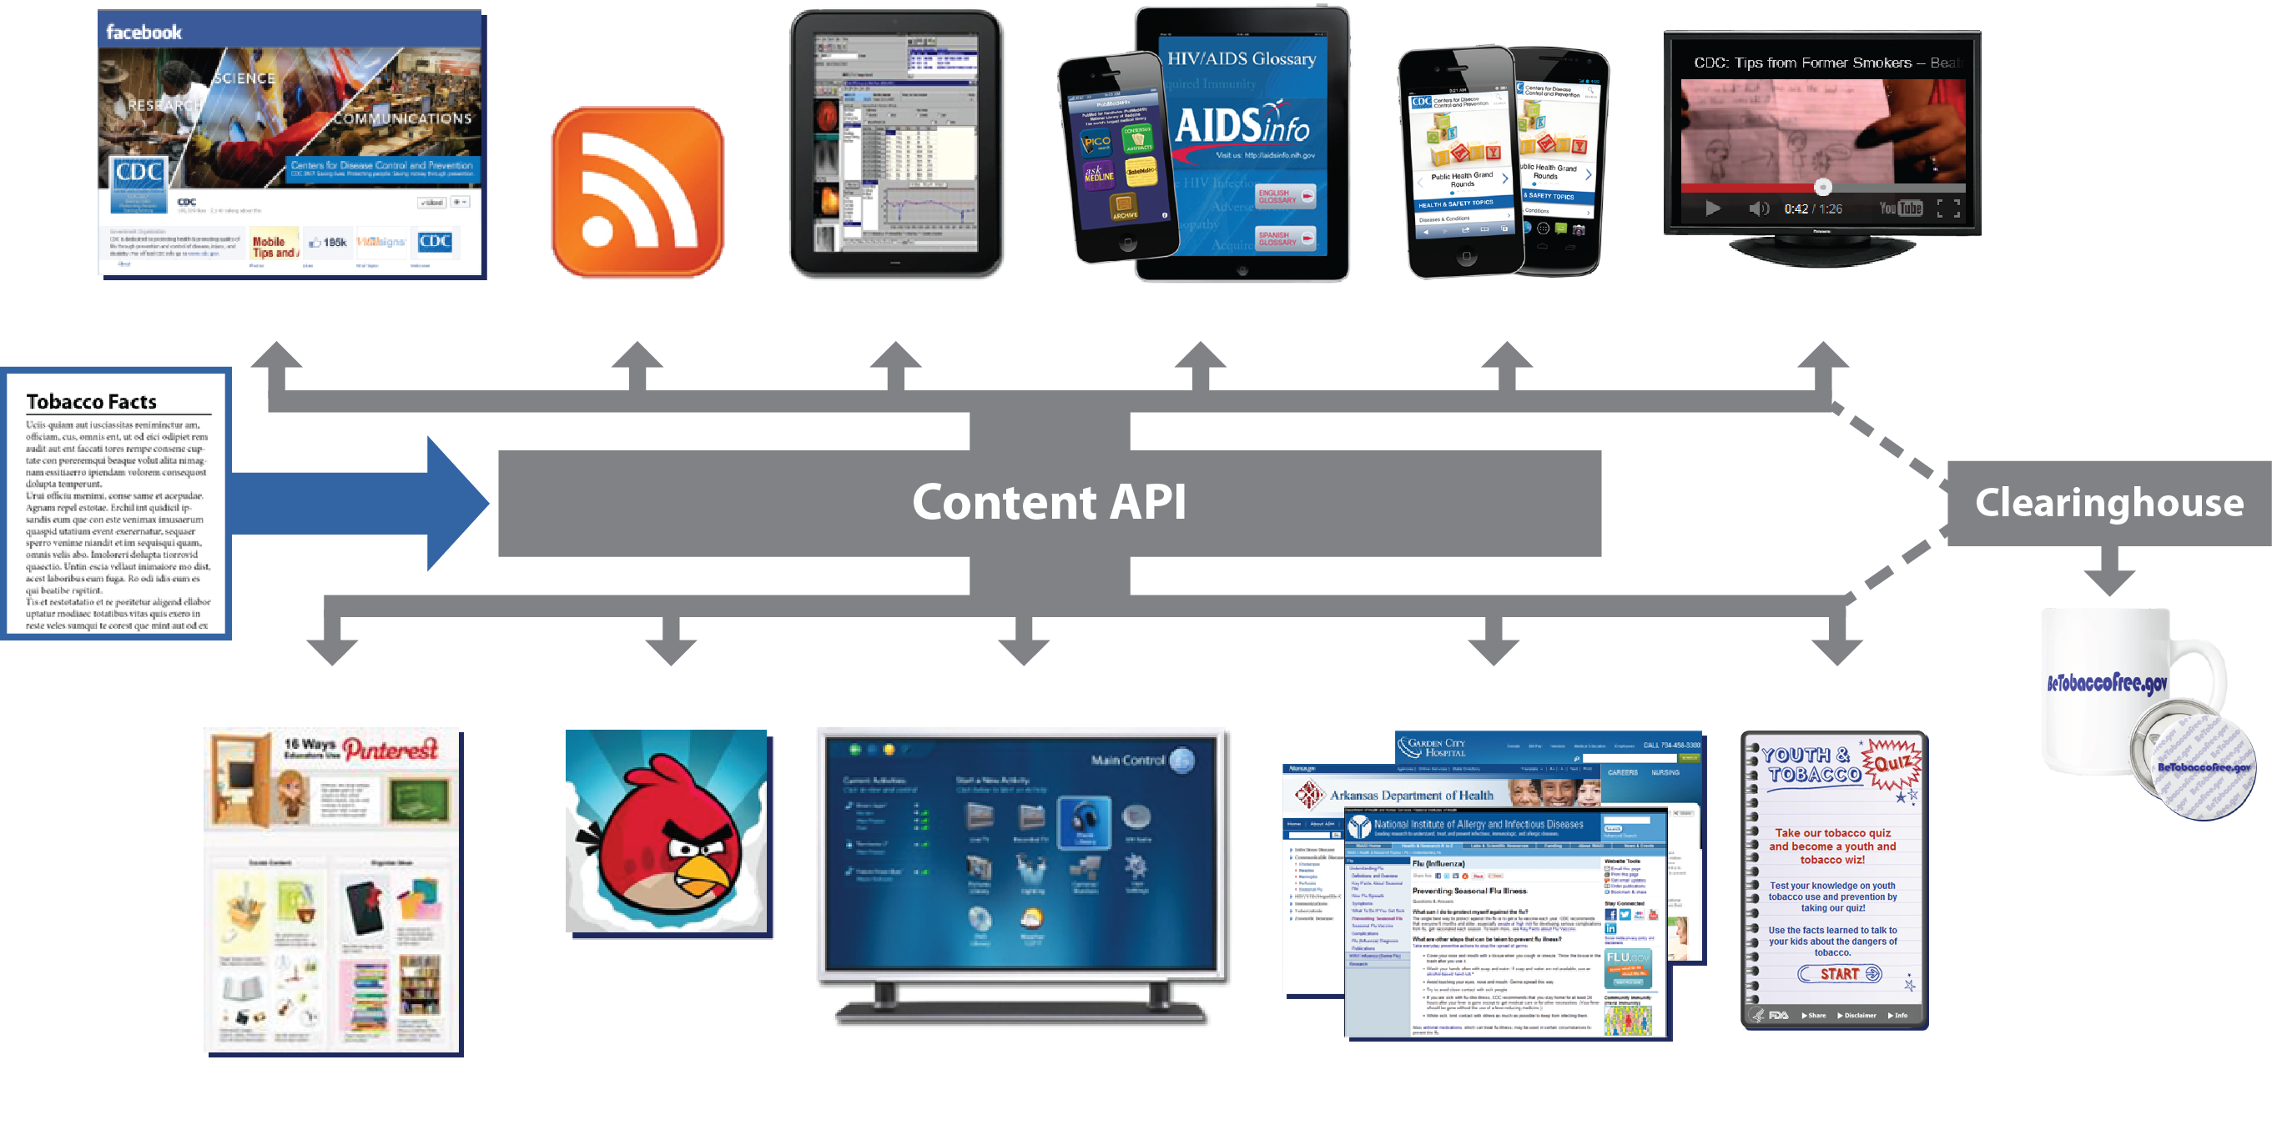
Sharing Content through Multiple Channels
See HowTo.Gov/API for more information and a quick video on APIs.
Notes:
Brief overview of CS

Slide 2
Content Syndication Sites
Health and Human Services
https://digitalmedia.hhs.gov/storefront/
Centers for Disease Control and Prevention
https://tools.cdc.gov/syndication/
Food and Drug Administration
https://tools.fda.gov/CSStorefront/
National Institutes of Health
https://tools.niaid.nih.gov/syndication/
Open Source
HHS Digital Media API Platform
More Information: Christen.Geiler@nih.gov

