Slide 1
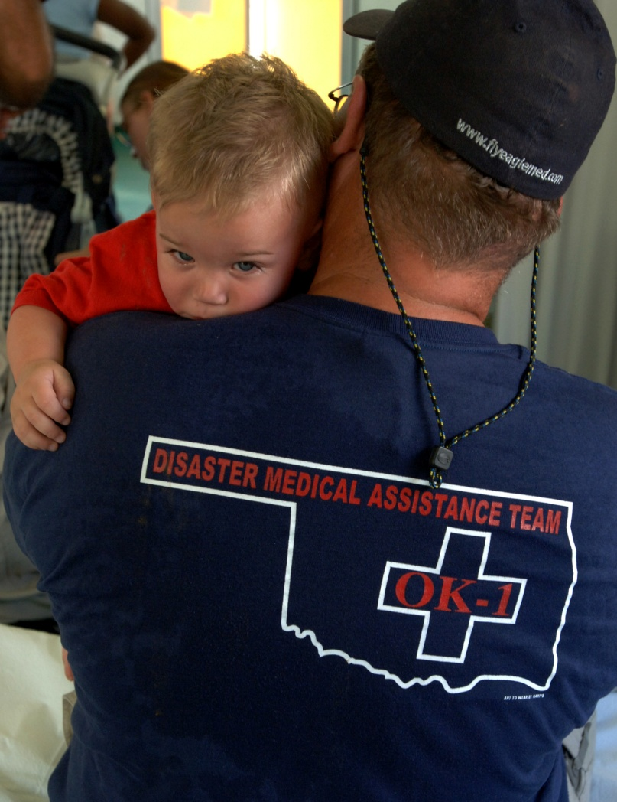
Disaster Medical
Information Suite
(DMIS)
Andrew Garrett, MD, MPH
Director, NDMS
Office of Emergency Management

Slide 2
Overarching Goals of DMIS
Support the mission
Establish an electronic health record for NDMS
Establish a tool for reliable tracking of patients
Promote real-time medical information to support command, control, and intelligence for leadership
Provide a mechanism for medical encounter data storage, analysis, and sharing
Maintain a system that is easy for our intermittent workforce to learn and use
Support the public and our partners
Facilitate sharing of health information to promote patient care (individual) and public health (aggregate)

Slide 3
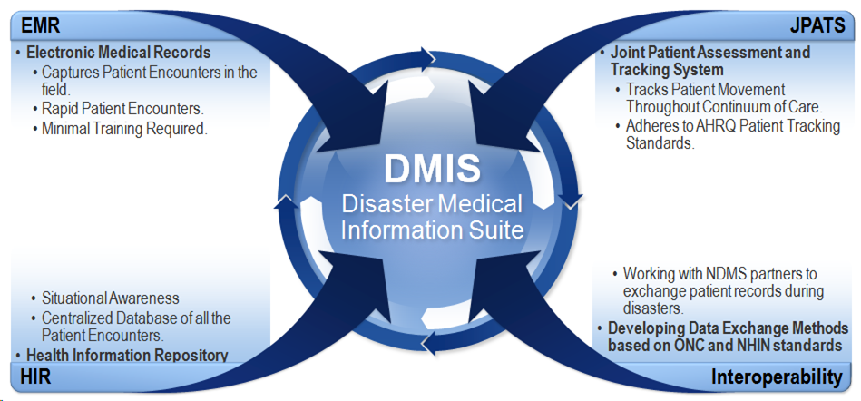
HHS ESF-8 DMIS Capabilities (actual and future)
FIELD
FORWARD SUPPORT
FIELD
HQ
PARTNERS
HQ
FORWARD SUPPORT
PARTNERS
FIELD
HQ
PARTNERS

Slide 4
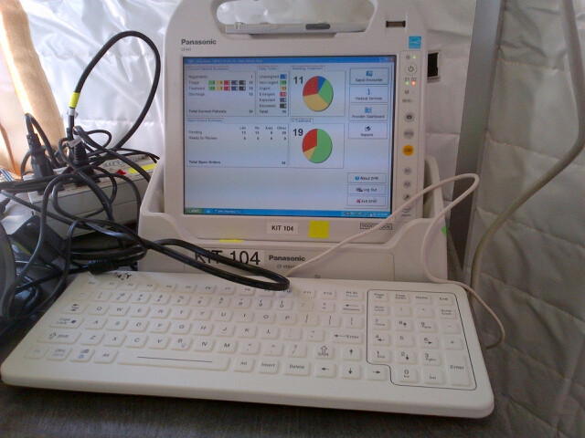
Ongoing Challenges for DMIS
Operating in a resource-challenged environment
Cloud vs. store local
Development vs. usability
Changes require retraining
Logistical challenges in a pre-positioned system
Hardware (cost, type)
Software (reimaging)
User support
Legacy system issues

Slide 5
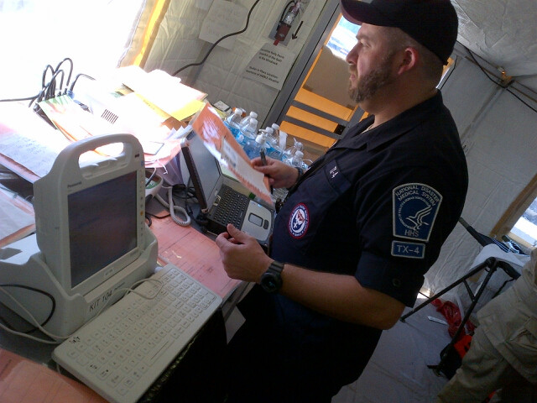
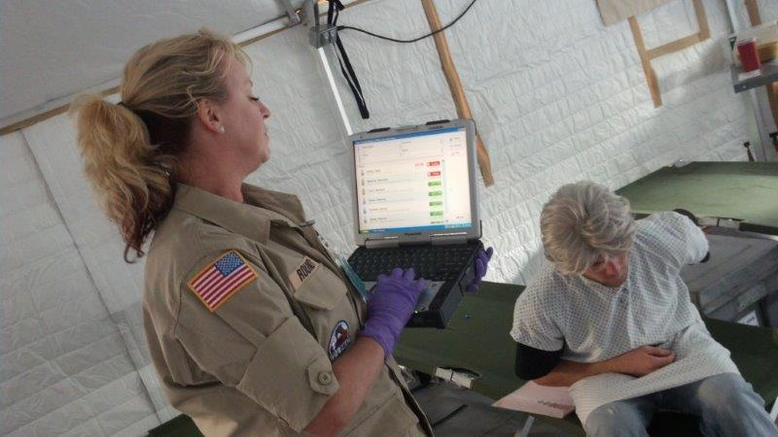
Future Opportunities for DMIS
Exploring the use of more modern IT
Tablets, servers, etc.
Remote update of software
Promote better patient care
Record transfer
eRx
Facilitate more informed research, QI, and surveillance
Improve medical intelligence during response through improved connectivity
Real time data sharing

Slide 6
