Slide 1
Stacy Elmer
Advisor to the Chief Technology Officer
Innovation, Design, Entrepreneurship and Action (IDEA) Lab
US Department of Health and Human Services

Slide 2
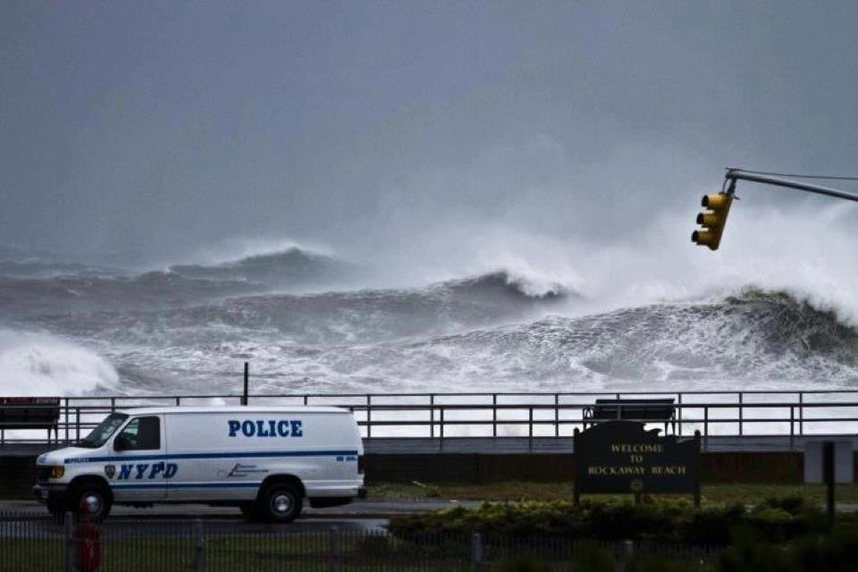
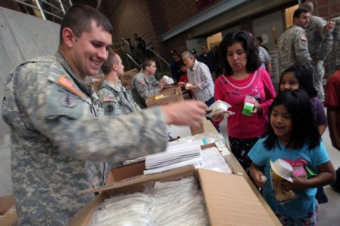
HURRICANE SANDY

Slide 3
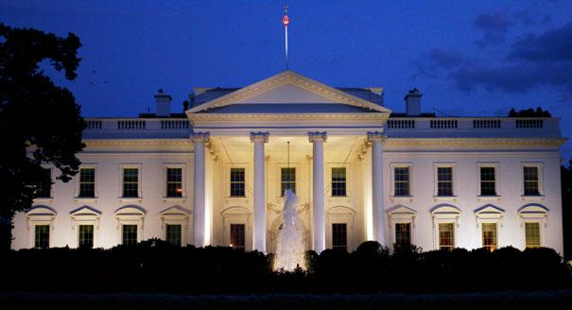
THE WHITE HOUSE

Slide 4
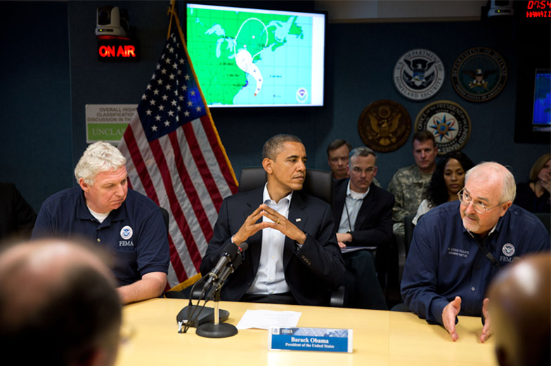
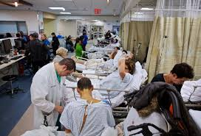
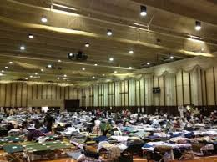
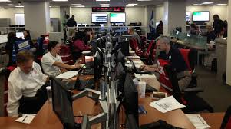

Slide 5
FREE!
FREE!
FREE!

Slide 7
FREE!
FREE!
Coordinating processes that are nimble and adaptable
FREE!
Mechanisms for working with the private sector

Slide 8
Brian Forde, OSTP
Products don’t last forever
Nerds do

Slide 9
Bryan Sivak
HHS Chief Technology Officer

